Slide 1
Computer Network (CS3002)
Spring Semester (2021-2022)
Dr. Judhistir Mahapatro
Department of Computer Science and Engineering
National Institute of Technology Rourkela

Slide 2
The Network Layer

Slide 3
Congestion Control Algorithms
Too many packets present in (a part of) the network causes packet delay and loss that degrades performance.
  This situation is called Congestion.
Network and transport layer share the responsibility for handling congestion.
Network layer directly experiences the congestion as it occurs within the network.

Slide 4
Congestion Control Algorithms
Most effective way to control this
  Reduce the load that the transport layer is placing on the network.

Slide 5
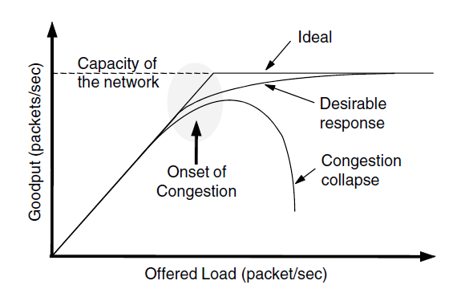
Congestion Control Algorithms
When too much traffic is offered, congestion sets in and performance degrades sharply.

Slide 6
Congestion Control Algorithms
Too many packets arriving in the input line and all need the same output line
  sufficient memory can solve the problem of packet drop.
  Adding more memory may help up to a point, Nagle (1987) realized that adding infinite memory, congestion gets worse, not better.
Timed out by the time the packets get to the front of the queue.
  Retransmissions increase the congestion collapse.

Slide 7
Congestion Control Algorithms
Congestion control has to do with making sure the network is able to carry the offered traffic.
  Global issue, involving the behavior of all the hosts and routers
  A host can get a slow down message
    either because the receiver cannot handle the load, or
    because the network cannot handle it.

Slide 8
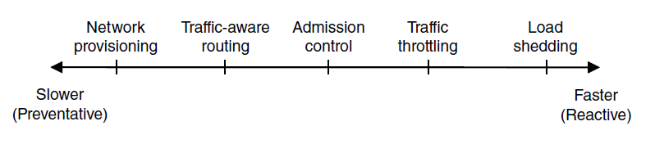
Approaches to Congestion Control
Timescales of approaches to congestion control

Slide 9
Approaches to congestion control
  Congestion means that the load is greater than the resources can handle.
    Increase the resources or decrease the load
    Resources can be dynamically added when there is a serious congestion
      Turning on spare routes
      Purchasing bandwidth on the open market
      Backups lines used
    Routers and links that are regularly heavily utilized are upgraded a the earliest opportunity. This is called provisioning.

Slide 10
Approaches to congestion control
  To make the most of the existing network capacity, routes can be tailored to traffic patterns that change during the day as network users wake and sleep in different time zones.
    Shift traffic away from heavily used paths.
    Changing the shortest path weights.
    This is called Traffic-aware routing.

Slide 11
Approaches to congestion control
  Sometimes it is not possible to increase capacity.
  The only way then to beat back the congestion is to decrease the load.
  In virtual-circuit networks, new connections can be refused if they would cause the network to become congested.
      This is called Admission Control.

Slide 12
Approaches to congestion control
  When congestion is imminent the network can request these sources to throttle or slow down their traffic
  Two difficulties
    How to identify the onset of congestion?
      Monitor average load, queuing delay, packet loss. Increasing trend indicate growing congestion.
    How to inform to source that needs to slow down?
        Routers must participate in a feedback loop with the sources.
        Having routers send more messages when network is already congested.

Slide 13
Approaches to congestion control
  When all else fails, the network is forced to discard packets that it cannot deliver. This is called load shedding.
  A good policy for choosing which packets to discard can help to prevent congestion collapse.

Slide 14
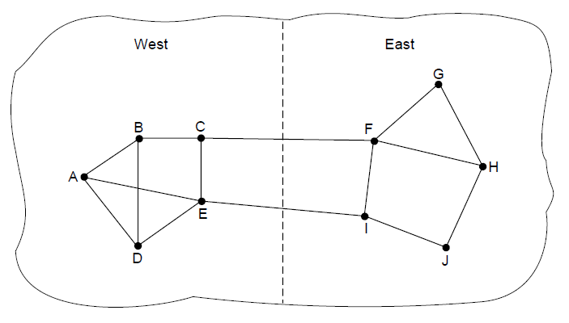
Traffic-Aware Routing
If link weight is based on load then routing tables may oscillate wildly, leading to chaos.
Multi-path routing is the solution (first)
Shift traffic across routes slowly enough that it is able to converge (second)
A network in which the East and West parts are connected by two links.

Slide 15
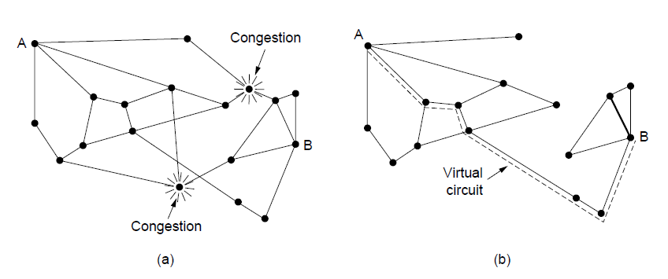
Admission Control
(a) A congested network. (b) The portion of the network that is not congested. A virtual circuit from A to B is also shown.

Slide 16
Traffic Throttling
Senders adjust their transmissions to send as much traffic as the network can readily deliver.
When congestion is imminent, it must tell senders to throttle back their transmissions and slow down.
  The term Congestion Avoidance is sometimes used
Routers must determine when congestion is approaching
  Monitor continuously the resources it is using
    Utilization of output links
    Buffering of queued packets
    #Packets lost due to insufficient buffering

Slide 17
Traffic Throttling
Queuing Delay inside routers directly captures any congestion experienced by packets.
  Good estimate of the queuing delay, d,
  d_{new} = α d_{old} + (1- α) s
  α: a constant that determines how fast the router forgets recent history.
  s: Instantaneous queue length
  - This is called Exponentially weighted moving
  average.
Whenever d moves above the threshold, the router notes that the onset of congestion.

Slide 18
Traffic Throttling
Routers must deliver timely feedback to the senders that are causing the congestion.
  To deliver feedback, router must identify the appropriate senders.
  Warn them carefully, without sending many more packets into the already congested network.

Slide 19
Traffic Throttling
Choke Packets
  Notify a sender of congestion is to tell it directly
  Router selects a congested packet and sends a choke packet back to the source host, giving it the destination found in the packet.
  Header bit is turned on so that no further choke packets are generated for it on the path. The packet is forwarded in the usual way.
  Source reduce the traffic to the destination by 50% after receiving a choke packet.

Slide 20
Choke Packets
  early Internet used the choke packet called SOURCE-QUENCH message.
  Modern Internet uses a notification design that is Explicit Congestion Notification.

Slide 21
Traffic Throttling
Explicit Congestion Notification.
  Instead additional packets to warn of congestion
    a router can tag any packet it forwards (by setting a bit in the packet’s header) to signal that it is experiencing congestion.
  When network delivered that packet to the destination
    destination informs about the same to the source through acknowledgement message.

Slide 22
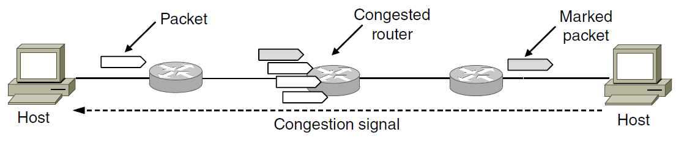
Traffic Throttling
Explicit congestion notification

Slide 23
Traffic Throttling
Hop-by-Hop Backpressure
    Alternative approach is to have the choke packet take effect at every hop it passes through.

Slide 24
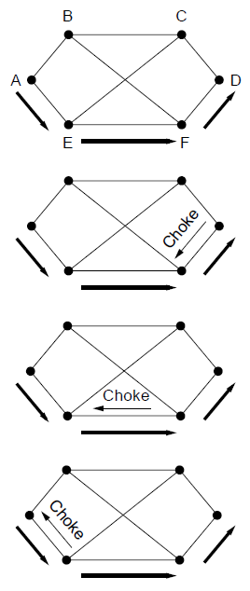
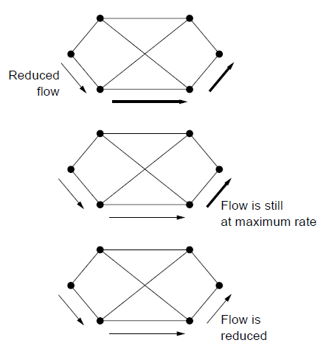
A choke packet that affects only the source.

Slide 25
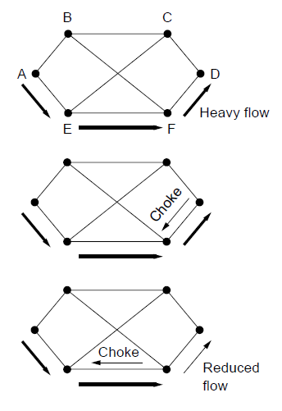
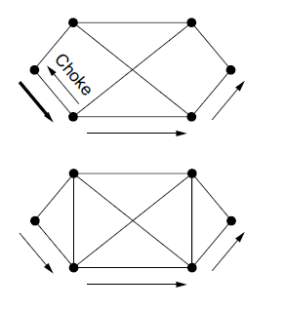
A choke packet that affects each hop it passes through.

Slide 26
Load Shedding
When routers are being inundated by packets that they cannot handle, they just throw them away.
  Question is which packets to drop
    Type of applications that use the network.
    In case of file transfer, old packet is worth more than new one.
    In case of real-time media, new packet is worth more than old one.
  Two policies
    Wine (older is better than new)
    Milk (new is better than old)
  More intelligent load shedding requires cooperation from the senders.

Slide 27
Random Early Detection
Running average of their queue length
It exceeds a threshold, small fraction of packets are dropped at random
It improves performance compared to routers that drop packets only when their buffers full.

Slide 28
Reference
Computer Networks, Fifth Edition by Andrew Tanenbaum and David Wetherall, Pearson Education-Prentice Hall, 2011

